Slide 1

Support Vector Machines

Slide 2
Support Vector Machines
Support Vector Machines are one of the more complex algorithms we will learn, but it all begins with a simple premise:
Does a hyperplane exist that can effectively separate classes?
To answer this question, we first need to go through the history and development of Support Vector Machines!

Slide 3
Support Vector Machines
Section Overview
History
Intuition and Theory for SVM
SVM Classification Example
SVM Regression Example
SVM Project Exercise and Solutions

Slide 4
Support Vector Machines
Relevant Reading in ISLR
Chapter 9 covers Support Vector Machine Classification
Wikipedia has a section on Support Vector Machine Regression.

Slide 5
Let’s get started!

Slide 6
Support Vector Machines
Theory and Intuition - History

Slide 7
Support Vector Machines
Support Vector Machines will be one of the most recently developed machine learning algorithms we will learn about!
Let’s briefly review the recent history behind the development of Support Vector Machines.

Slide 8
Support Vector Machines
Quick Note:
Spelling of some names and article titles may be slightly altered due to various translation options from Russian to English (e.g. Alexey vs. Alexei).

Slide 9
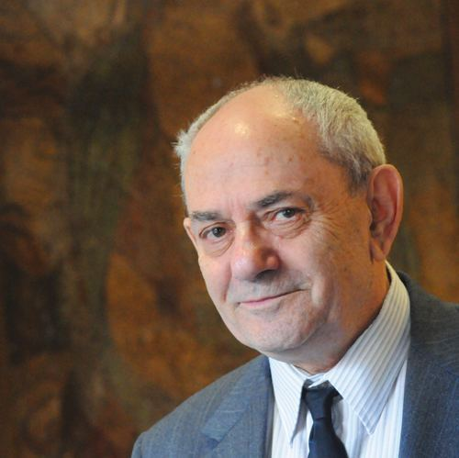
Support Vector Machines
1960s: Vladimir Vapnik obtained his Ph.D in statistics at the Institute of Control Sciences in Moscow.
Worked at the Institute
from 1961-1990.

Slide 10
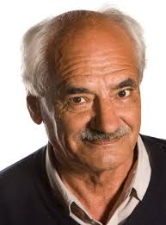
Support Vector Machines
1960s: Alexey Chervonenkis and Vladimir Vapnik begin the development of Support Vector Machines.

Slide 11
Support Vector Machines
1963: Published “Generalized Portrait Algorithm” for image analysis by computers.

Slide 12
Support Vector Machines
1964: Aizerman, Braverman, and Rozonoer, publish “Theoretical Foundations of the Potential Function Method” in Pattern Recognition Learning.
Introduces the geometrical interpretation of the kernels as inner products in a feature space.

Slide 13
Support Vector Machines
1974: Vapnik and Chervonenkis continue work, publishing “Theory of Pattern Recognition”.

Slide 14
Support Vector Machines
1960s-1990s: Vapnik continues to work on further developing Support Vector Machines.

Slide 15
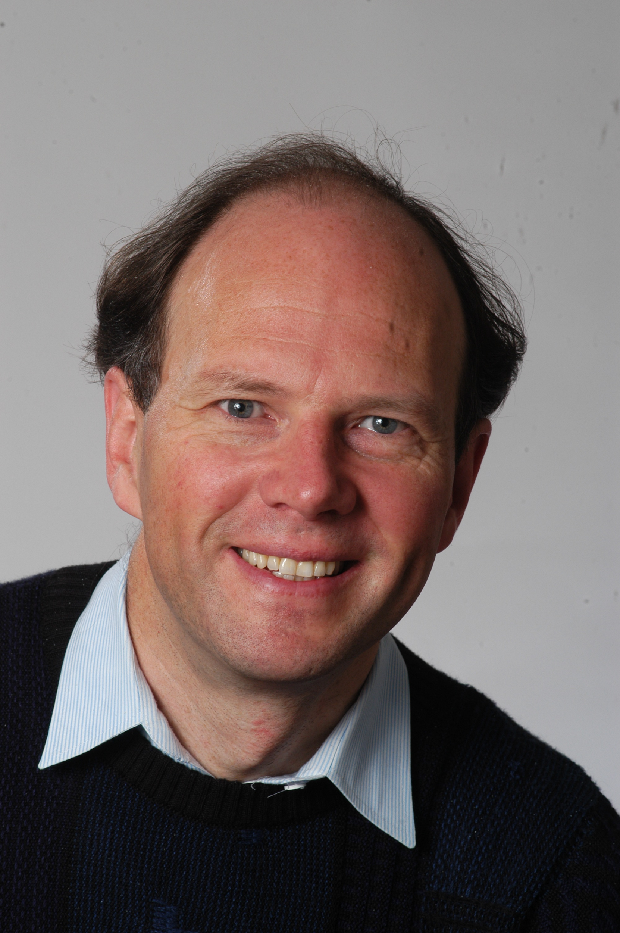

Support Vector Machines
1992: Bernhard Boser, Isabelle Guyon and Vladimir Vapnik suggested a way to create nonlinear classifiers by applying the kernel trick to maximum-margin hyperplanes.

Slide 16

Support Vector Machines
1995: Corinna Cortes and Vladimir Vapnik publish the SVM incarnation utilizing a soft margin.

Slide 17
Support Vector Machines
1996: Vladimir Vapnik, Harris Drucker, Christopher Burges, Linda Kaufman and Alexander Smola publish “Support Vector Regression Machines”, expanding SVM beyond classification tasks.

Slide 18
Support Vector Machines
It took over 30 years of work to get to the version of Support Vector Machines we will be using!
Work continues today with improvements in implementation and performance, as well as theoretical advancements.

Slide 19
Support Vector Machines
As we begin to learn about the intuition and theory behind Support Vector Machines, keep in mind this steady progress.
We will see it advance clearly as we move from Maximum Margin Classifiers, to Support Vector Classifiers, and finally Support Vector Machines.

Slide 20
Support Vector Machines
Theory and Intuition - Hyperplanes and Margins

Slide 21
Support Vector Machines
We will slowly build up to SVMs:
Maximum Margin Classifier
Support Vector Classifier
Support Vector Machines
Let’s begin by understanding what a hyperplane is...

Slide 22
Support Vector Machines
In an N-dimensional space, a hyperplane is a flat affine subspace of hyperplane dimension N − 1.
For example:
1-D Hyperplane is a single point
2-D Hyperplane is a line
3-D Hyperplane is flat plane

Slide 23
Support Vector Machines
1-D Hyperplane is a single point
X

Slide 24
Support Vector Machines
1-D Hyperplane is a single point
X

Slide 25
Support Vector Machines
2-D Hyperplane is a line
X2
X1

Slide 26
Support Vector Machines
2-D Hyperplane is a line
X2
X1

Slide 27
Support Vector Machines
3-D Hyperplane is a flat plane
X3
X1
X2

Slide 28
Support Vector Machines
The main idea behind SVM is that we can use Hyperplanes to create a separation between classes.
Then new points will fall on one side of this separating hyperplane, which we can then use to assign a class.

Slide 29
Support Vector Machines
Imagine a data set with one feature and one binary target label.
For example:
A weight feature for baby chicks
Classified by Male or Female
What would this look like visualized?

Slide 30
Support Vector Machines
Place points along feature.
WEIGHT
MALE
FEMALE

Slide 31
Support Vector Machines
Notice in this case, classes are perfectly separable. This is unlikely in real world datasets.
WEIGHT
MALE
FEMALE

Slide 32
Support Vector Machines
Idea behind SVM is to create a separating hyperplane between the classes.
WEIGHT
MALE
FEMALE

Slide 33
Support Vector Machines
A new point would be classified based on what side of the point they land on.
WEIGHT
MALE
FEMALE

Slide 34
Support Vector Machines
A new point would be classified based on what side of the point they land on.
MALE
WEIGHT
MALE
FEMALE

Slide 35
Support Vector Machines
A new point would be classified based on what side of the point they land on.
FEMALE
WEIGHT
MALE
FEMALE

Slide 36
Support Vector Machines
How do we choose where to put this separating hyperplane?
WEIGHT
MALE
FEMALE

Slide 37
Support Vector Machines
Note there are many options that perfectly separate out these classes:
WEIGHT
MALE
FEMALE

Slide 38
Support Vector Machines
Which of these is the “best” separator between the classes?
WEIGHT
MALE
FEMALE

Slide 39
Support Vector Machines
We could use the separator that maximizes the margins between the classes.
WEIGHT
MALE
FEMALE

Slide 40
Support Vector Machines
We could use the separator that maximizes the margins between the classes.
WEIGHT
MALE
FEMALE

Slide 41
Support Vector Machines
This is known as a Maximal Margin Classifier.
WEIGHT
MALE
FEMALE

Slide 42
Support Vector Machines
This same idea of maximum margins applies to N-dimensions.
WEIGHT
MALE
FEMALE

Slide 43
Support Vector Machines
Imagine a 2 dimensional feature space:
MALE
FEMALE
HEIGHT
WEIGHT

Slide 44
Support Vector Machines
Separating hyperplane is a line.
MALE
FEMALE
HEIGHT
WEIGHT

Slide 45
Support Vector Machines
Multiple possible hyperplanes:
MALE
FEMALE
HEIGHT
WEIGHT

Slide 46
Support Vector Machines
Choose to maximize margins:
MALE
FEMALE
HEIGHT
WEIGHT

Slide 47
Support Vector Machines
Note each data point is a 2D vector:
MALE
FEMALE
HEIGHT
WEIGHT

Slide 48
Support Vector Machines
Data points at margin “support” separator:
MALE
FEMALE
HEIGHT
WEIGHT

Slide 49
Support Vector Machines
What happens if classes are not perfectly separable?
WEIGHT
MALE
FEMALE

Slide 50
Support Vector Machines
We are not be able to separate without allowing for misclassifications.
WEIGHT
MALE
FEMALE

Slide 51
Support Vector Machines
We are not be able to separate without allowing for misclassifications.
WEIGHT
MALE
FEMALE

Slide 52
Support Vector Machines
We will have a bias-variance trade-off depending where we place this separator:
WEIGHT
MALE
FEMALE

Slide 53
Support Vector Machines
For one feature this classifier creates ranges for male and female:
WEIGHT
MALE
FEMALE

Slide 54
Support Vector Machines
This fit only misclassified one female training point as male:
WEIGHT
MALE
FEMALE

Slide 55
Support Vector Machines
This looks like a high variance fit to training data, picking too much noise from Female:
WEIGHT
MALE
FEMALE

Slide 56
Support Vector Machines
A new test point close to existing female weights could get classified as male:
WEIGHT
MALE
FEMALE

Slide 57
Support Vector Machines
We will have a bias-variance trade-off depending where we place this separator:
WEIGHT
MALE
FEMALE

Slide 58
Support Vector Machines
Here we allow more bias to lead to better long term results on future data:
WEIGHT
MALE
FEMALE

Slide 59
Support Vector Machines
Here we allow more bias to lead to better long term results on future data:
WEIGHT
MALE
FEMALE

Slide 60
Support Vector Machines
Distance between threshold and the observations is a soft margin:
WEIGHT
MALE
FEMALE

Slide 61
Support Vector Machines
Soft margin allows for misclassification inside the margins.
WEIGHT
MALE
FEMALE

Slide 62
Support Vector Machines
There are many possible threshold splits if we allow for soft margins.
WEIGHT
MALE
FEMALE

Slide 63
Support Vector Machines
We can use cross validation to determine the optimal size of the margins.
WEIGHT
MALE
FEMALE

Slide 64
Support Vector Machines
2D soft margin example:
MALE
FEMALE
HEIGHT
WEIGHT

Slide 65
Support Vector Machines
Data set is technically perfectly separable
MALE
FEMALE
HEIGHT
WEIGHT

Slide 66
Support Vector Machines
Maximal Margin Classifier
MALE
FEMALE
HEIGHT
WEIGHT

Slide 67
Support Vector Machines
Maximal Margin Classifier
MALE
FEMALE
HEIGHT
WEIGHT

Slide 68
Support Vector Machines
Support Vector Classifier (Soft Margins)
MALE
FEMALE
HEIGHT
WEIGHT

Slide 69
Support Vector Machines
Support Vector Classifier (Soft Margins)
MALE
FEMALE
HEIGHT
WEIGHT

Slide 70
Support Vector Machines
Support Vector Classifier (Soft Margins)
MALE
FEMALE
HEIGHT
WEIGHT

Slide 71
Support Vector Machines
We’ve only visualized cases where the classes are easily separated by the hyperplane in the original feature space.
Allowing for some misclassifications still resulted in reasonable results.
What would happen in a case where a hyperplane performs poorly, even when allowing for misclassifications?

Slide 72
Support Vector Machines
Notice a single hyperplane won’t separate out the classes without many misclassifications!
FEATURE
MALE
FEMALE

Slide 73
Support Vector Machines
Notice a single hyperplane won’t separate out the classes without many misclassifications!
FEATURE
MALE
FEMALE

Slide 74
Support Vector Machines
Notice a single hyperplane won’t separate out the classes without many misclassifications!
FEATURE
MALE
FEMALE

Slide 75
Support Vector Machines
Notice a single hyperplane won’t separate out the classes without many misclassifications!
FEATURE
MALE
FEMALE

Slide 76
Support Vector Machines
Can’t split classes with hyperplane line:
MALE
FEMALE
FEATURE
FEATURE

Slide 77
Support Vector Machines
To solve these cases, we move on from Support Vector Classifier, to Support Vector Machines.
SVMs use kernels to project the data to a higher dimension, in order to use a hyperplane in this higher dimension to separate the data.

Slide 78
Support Vector Machines
Theory and Intuition - Kernels

Slide 79
Support Vector Machines
Kernels allow us to move beyond a Support Vector Classifier and use Support Vector Machines.
There are a variety of kernels we can use to “project” the features to a higher dimension.
Let’s explore how this works through some visual examples...

Slide 80
Support Vector Machines
Recall our 1D example of classes not easily separated by a single hyperplane:
NO DEFAULT
DEFAULT
X

Slide 81
Support Vector Machines
Let’s explore how using a kernel could project this feature onto another dimension.
NO DEFAULT
DEFAULT
X

Slide 82
Support Vector Machines
For example, a polynomial kernel could expand onto an X² dimension:
NO DEFAULT
DEFAULT
X

Slide 83
Support Vector Machines
For example, a polynomial kernel could expand onto an X² dimension:
NO DEFAULT
DEFAULT
-10
0
10

Slide 84
Support Vector Machines
For example, a polynomial kernel could expand onto an X² dimension:
X²
NO DEFAULT
DEFAULT
-10
0
10

Slide 85
Support Vector Machines
For example, a polynomial kernel could expand onto an X² dimension:
X²
NO DEFAULT
DEFAULT
-10
0
10

Slide 86
Support Vector Machines
Create a hyperplane after this projection:
X²
NO DEFAULT
DEFAULT
-10
0
10

Slide 87
Support Vector Machines
Create a hyperplane after this projection:
X²
NO DEFAULT
DEFAULT
-10
0
10

Slide 88
Support Vector Machines
Use kernel projection to evaluate new points:
X²
NO DEFAULT
DEFAULT
-10
0
10

Slide 89
Support Vector Machines
Use kernel projection to evaluate new points:
X²
NO DEFAULT
DEFAULT
-10
0
10

Slide 90
Support Vector Machines
Use kernel projection to evaluate new points:
X²
NO DEFAULT
DEFAULT
-10
0
10

Slide 91
Support Vector Machines
Use kernel projection to evaluate new points:
X²
NO DEFAULT
DEFAULT
-10
0
10

Slide 92
Support Vector Machines
Imagine a 2D feature space where a hyperplane can not separate effectively, even with soft margins.
X2
X1

Slide 93
Support Vector Machines
We use Support Vector Machines to enable the use of a kernel transformation to project to a higher dimension.

Slide 94
Support Vector Machines
2D to 3D

Slide 95
Support Vector Machines
2D to 3D

Slide 96
Support Vector Machines
Hyperplane

Slide 97
Support Vector Machines
You may have heard of the use of kernels in SVM as the “kernel trick”.
We previously visualized transforming data points from one dimension into a higher dimension.
Mathematically, the kernel trick actually avoids recomputing the points in a higher dimensional space!

Slide 98
Support Vector Machines
How does the kernel trick achieve this?
It takes advantage of dot products of the transpositions of the data.
In the next lecture, we will go through the basic mathematical ideas behind the “kernel trick”!

Slide 99
Support Vector Machines
Theory and Intuition - Kernel Trick and Math

Slide 100
Support Vector Machines
Let’s briefly go over some of the general mathematics of SVM and how it is related to the Scikit-Learn class calls.
We’ll begin with a brief review of using margin based classifiers, and how they can be described with equations.
Note: Feel free to consider this an “optional” lecture.

Slide 101
Support Vector Machines
Relative Reading:
Background in Chapter 9 of ISLR.
For a comprehensive overview of everything discussed, check out:
Cortes, Corinna; Vapnik, Vladimir N. (1995). "Support-vector networks". Machine Learning.

Slide 102
Support Vector Machines
Hyperplanes Defined
X2
X1

Slide 103
Support Vector Machines
Hyperplanes Defined
X2
X1

Slide 104
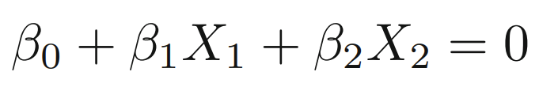
Support Vector Machines
Hyperplanes Defined
X2
X1

Slide 105
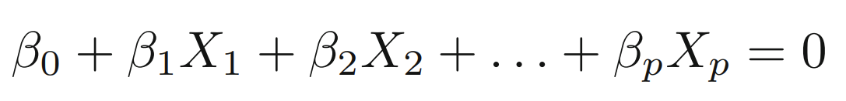
Support Vector Machines
Hyperplanes Defined
X2
X1

Slide 106
Support Vector Machines
Separating Hyperplanes
X2
X1

Slide 107
Support Vector Machines
Separating Hyperplanes
X2
X1

Slide 108
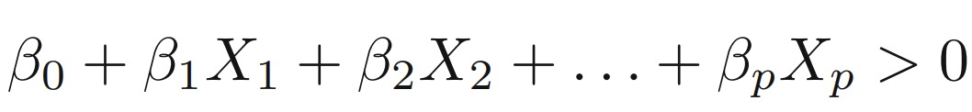
Support Vector Machines
Separating Hyperplanes
X2
X1

Slide 109
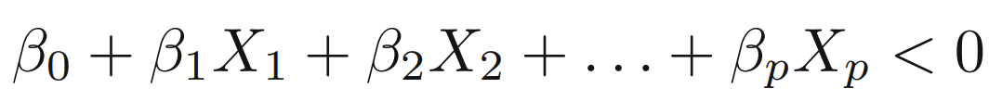
Support Vector Machines
Separating Hyperplanes
X2
X1

Slide 110
Support Vector Machines
Separating Hyperplanes
X2
X1

Slide 111
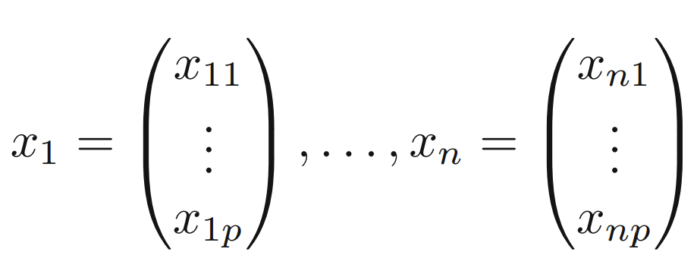
Support Vector Machines
Data Points
X2
X1

Slide 112
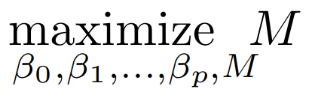
Support Vector Machines
Max Margin Classifier
X2
X1

Slide 113
Support Vector Machines
Max Margin Classifier
X2
X1

Slide 114
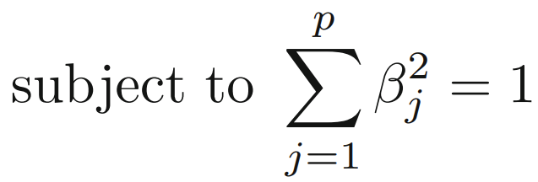

Support Vector Machines
Max Margin Classifier
X2
X1

Slide 115
Support Vector Machines
Max Margin Classifier
X2
X1

Slide 116
Support Vector Machines
Max Margin Classifier
X2
X1

Slide 117
Support Vector Machines
Max Margin Classifier
X2
X1

Slide 118
Support Vector Machines
Max Margin Classifier
X2
X1

Slide 119
Support Vector Machines
Max Margin Classifier
X2
X1

Slide 120
Support Vector Machines
Max Margin Classifier
X2
X1

Slide 121
Support Vector Machines
Support Vector Classifier
X2
X1

Slide 122
Support Vector Machines
Support Vector Classifier
X2
X1

Slide 123
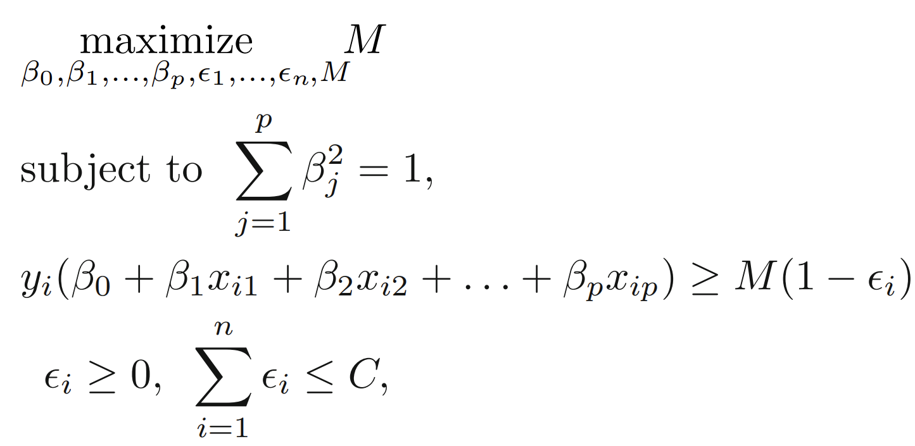
Support Vector Machines
Support Vector Classifier
X2
X1

Slide 124
Support Vector Machines
Support Vector Classifier
X2
X1

Slide 125
Support Vector Machines
Support Vector Classifier
X2
X1

Slide 126
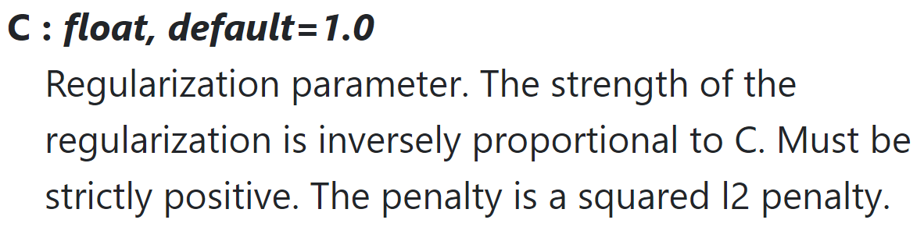
Support Vector Machines
Note on Scikit-Learn’s SVC!
X2
X1

Slide 127
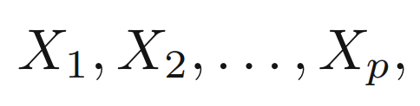
Support Vector Machines
Support Vector Machines
X2
X1

Slide 128
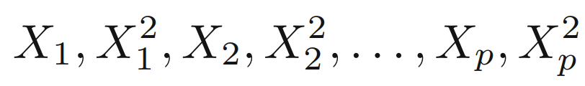
Support Vector Machines
Support Vector Machines
X2
X1

Slide 129
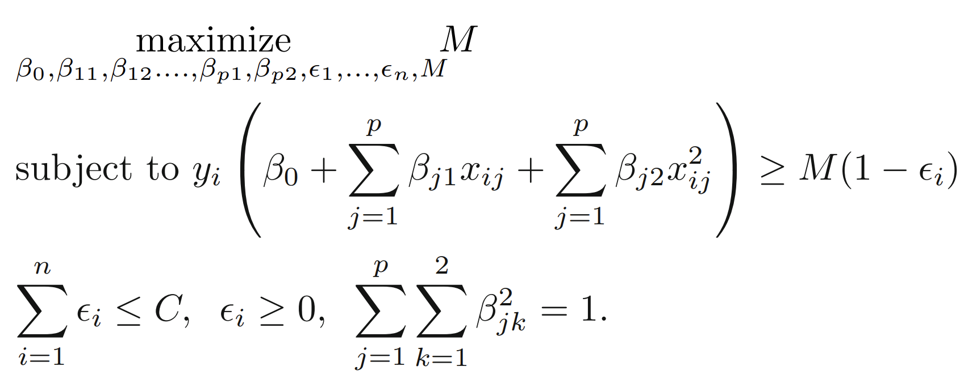
Support Vector Machines
Support Vector Machines
X2
X1

Slide 130
Support Vector Machines
Support Vector Machines
X2
X1

Slide 131
Support Vector Machines
Support Vector Machines
X2
X1

Slide 132
Support Vector Machines
How to deal with very large feature space?
As polynomial order grows larger, the number of computations necessary to solve for margins also grows!
The answer lies in the kernel trick which makes use of the inner product of vectors, also known as the dot product.

Slide 133
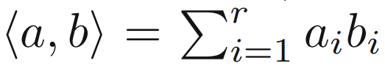
Support Vector Machines
Dot Product
a
b

Slide 134
Support Vector Machines
Dot Product
a
b

Slide 135
Support Vector Machines
Dot Product
a₁
a
b
b₁

Slide 136
Support Vector Machines
Dot Product
a₁
a
a₂
b
b₂
b₁

Slide 137
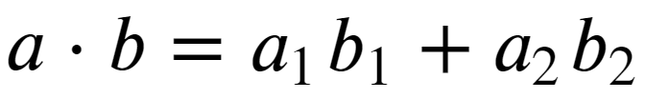
Support Vector Machines
Dot Product
a₁
a
a₂
b
b₂
b₁

Slide 138
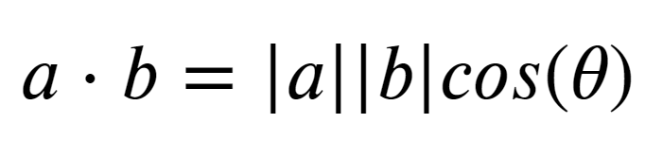
Support Vector Machines
Dot Product
a₁
a
a₂
θ
b
b₂
b₁

Slide 139
Support Vector Machines
Notice how the dot product can be thought of as a similarity between the vectors.
a
θ
b

Slide 140
Support Vector Machines
cos(0º) = 1
cos(90º) = 0
cos(180º) = -1
a
θ
b

Slide 141
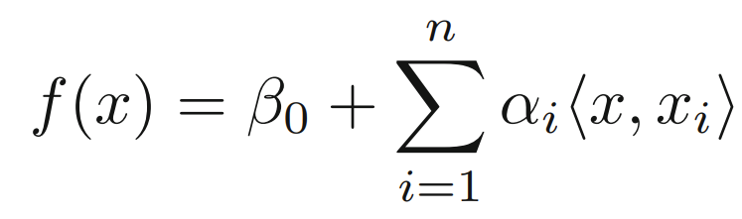
Support Vector Machines
Linear Support Vector Classifier rewritten:
X2
Calculating the inner products of all pairs of training observations
X1

Slide 142
Support Vector Machines
Linear Support Vector Classifier rewritten:
X2
Only non-zero for the support vectors.
X1

Slide 143
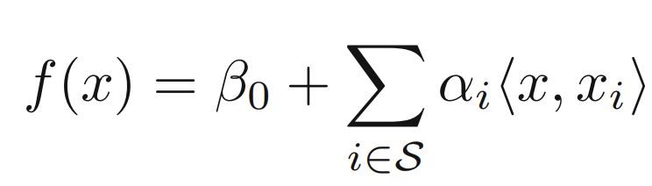
Support Vector Machines
Linear Support Vector Classifier rewritten:

Slide 144
Support Vector Machines
Linear Support Vector Classifier rewritten:
S collection of indices of these support points

Slide 145
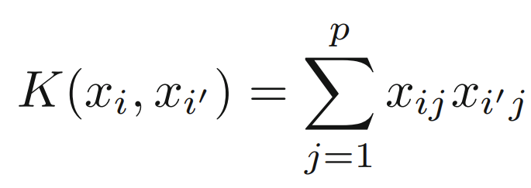
Support Vector Machines
Kernel Function
A kernel is a function that quantifies the similarity of two observations.

Slide 146
Support Vector Machines
Kernel Function

Slide 147
Support Vector Machines
Kernel Function

Slide 148
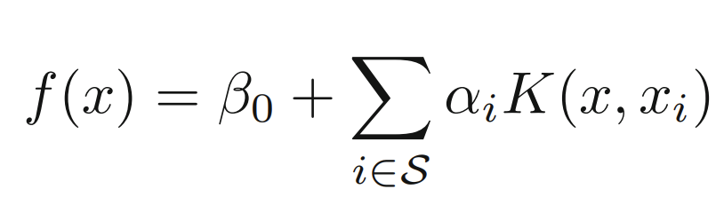
Support Vector Machines
Kernel Function

Slide 149
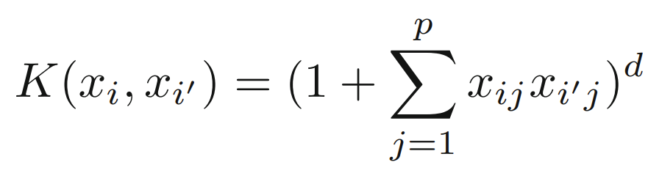
Support Vector Machines
Polynomial Kernel

Slide 150
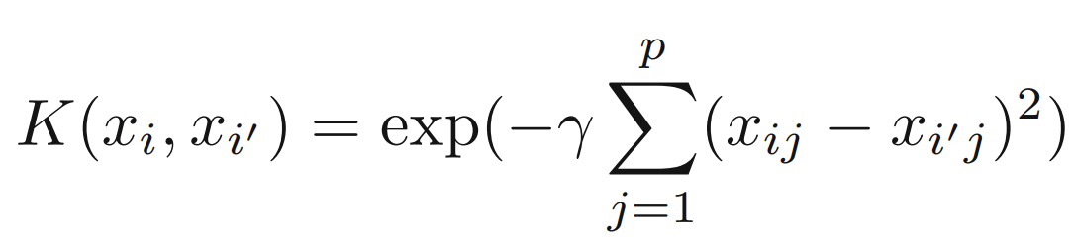
Support Vector Machines
Radial Basis Kernel

Slide 151
Support Vector Machines
The use of kernels as a replacement is known as the kernel trick.
Kernels allow us to avoid computations in the enlarged feature space, by only needing to perform computations for each distinct pair of training points (details in 9.3.2 in ISLR).

Slide 152
Support Vector Machines
Intuitively we’ve already seen inner products act as a measurement of similarity between vectors.
The use of kernels can be thought of as a measure of similarity between the original feature space and the enlarged feature space.

Slide 153
Support Vector Machines
Now that we understand the theory and intuition behind SVMs, let’s move on to actually using them with code!

Slide 154
Support Vector Machines
Classification with Scikit-Learn - Part One

Slide 155
Support Vector Machines
Note we will use a function from a .py file included in the Support Vector Machine folder!

Slide 156
Support Vector Machines
Classification with Scikit-Learn - Part Two

Slide 157
Support Vector Machines
Regression with Scikit-Learn - Part One

Slide 158
Support Vector Machines
Support Vector Regression
Y
X

Slide 159
Support Vector Machines
Support Vector Regression
Y
X

Slide 160
Support Vector Machines
Support Vector Regression
Y
X

Slide 161
Support Vector Machines
Support Vector Regression
Y
X

Slide 162
Support Vector Machines
Support Vector Regression
Y
X

Slide 163
Support Vector Machines
Support Vector Regression
Y
X

Slide 164
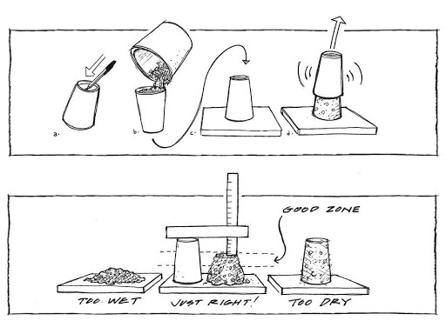
Support Vector Machines
Concrete Slump Test

Slide 165
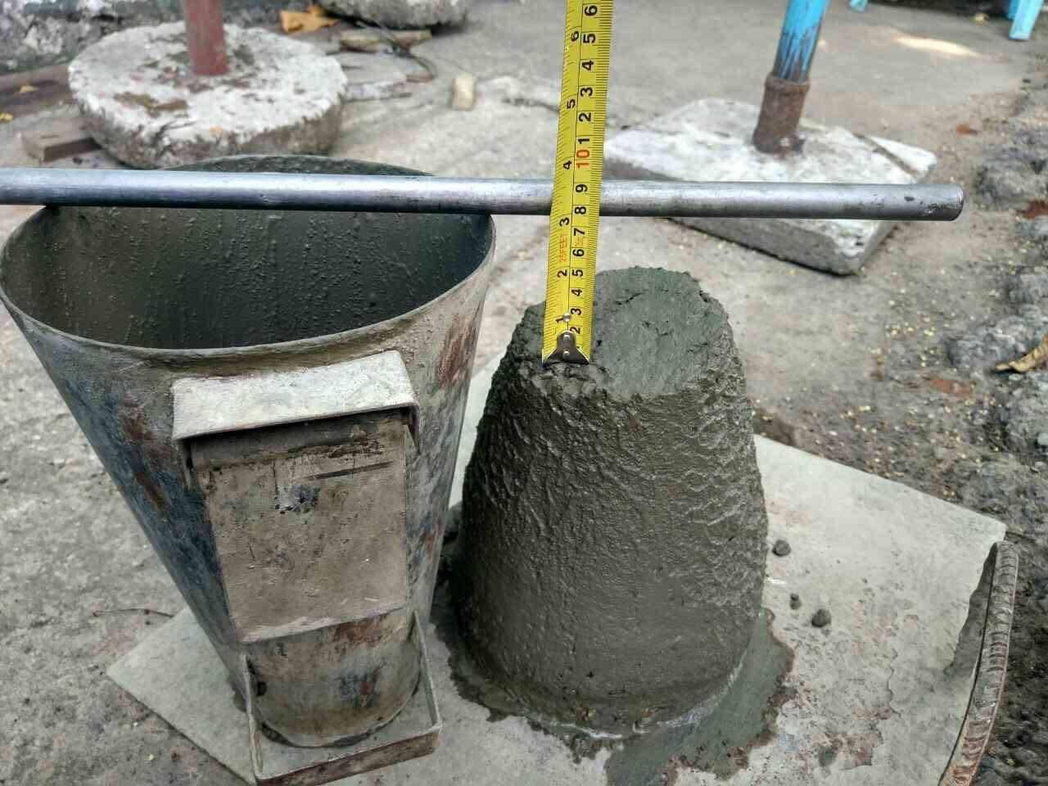
Support Vector Machines
Concrete Slump Test

Slide 166
Support Vector Machines
Support Vector Regression
Y
X

Slide 167
Support Vector Machines
Support Vector Regression
Y
X

Slide 168
Support Vector Machines
Support Vector Regression
Y
X

Slide 169
Support Vector Machines
Project Exercise

Slide 170
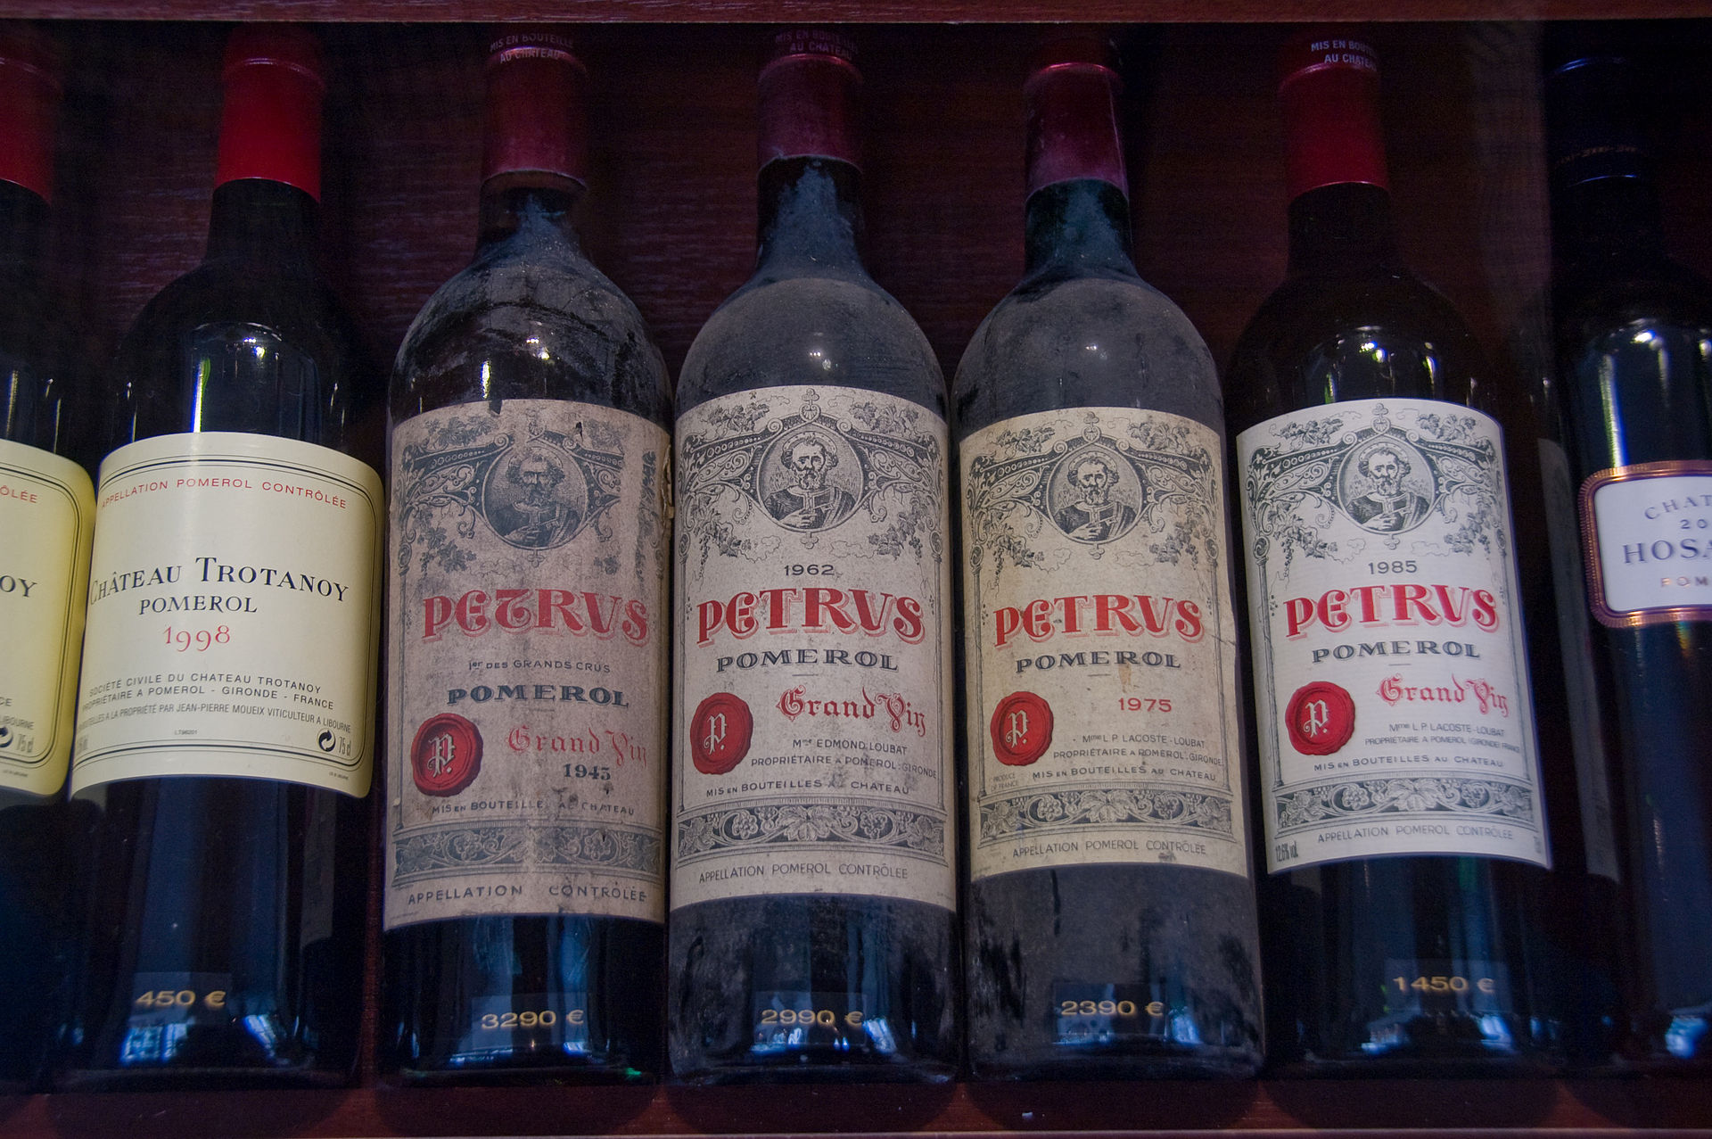
Support Vector Machines
Can you detect fraudulent wine based on features from a chemical analysis?

Slide 171
Support Vector Machines
Is this problem even solvable? Are “fraud” wines really different than “real” wines?

Slide 172
Support Vector Machines
Project Solutions

